Slide 1

CYBER
Warner & spencer
SECURITY
Phishing Awareness

Slide 2
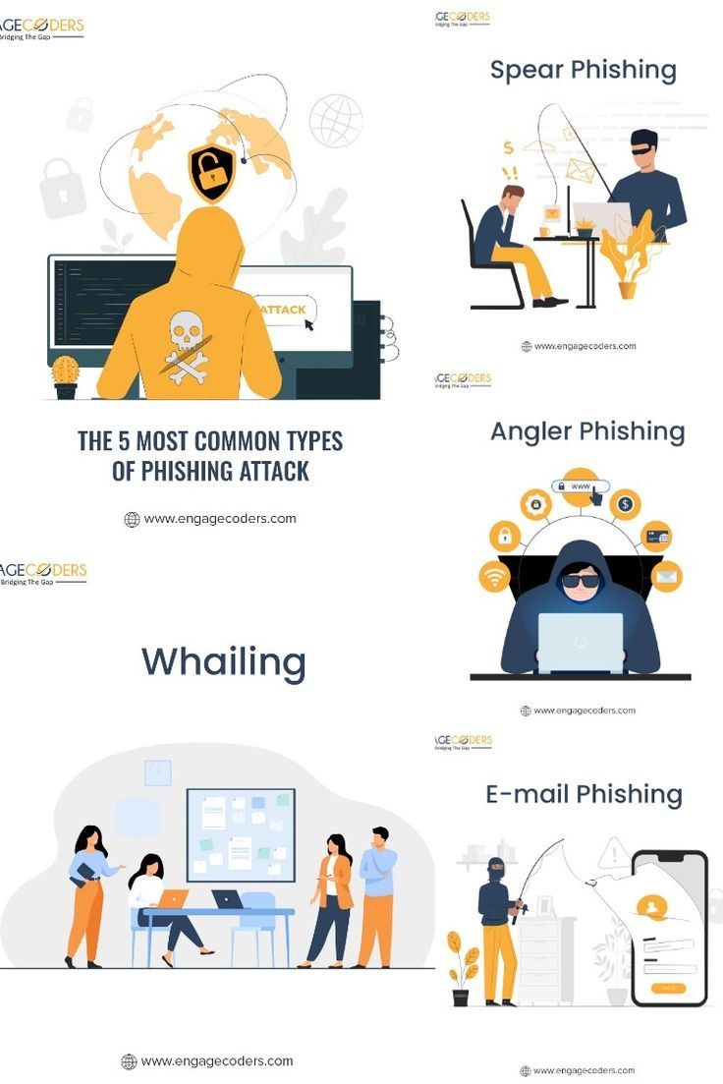



TOPIC OUTLINE
1
Introduction
2
Password Safety
3
Phishing Awareness
4
Common types of phishing attacks
5
Phishing websites identification
6
Social Media Safety
7
Privacy Settings
8
Conclusion

Slide 3

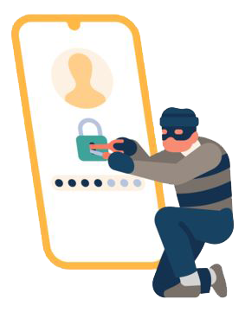
INTRODUCTION
Phishing attacks remain one of the most common and effective cyber threats facing individuals and organizations today. This training module will help you understand, identify, and protect yourself from various types of phishing attempts.
3

Slide 4


DIGITAL SAFETY TIPS
PASSWORD SAFETY
Create strong passwords with a combination of letters, numbers, and symbols. Use a different password for each account and change them regularly.
Don't use easy-to-guess passwords like 'password123' or 'qwerty'. Instead, use a unique combination of letters, numbers, and symbols for each account.
4

Slide 5
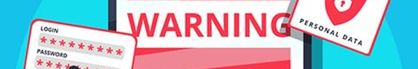
DIGITAL SAFETY TIPS
PHISHING AWARENESS
Phishing is a form of social engineering where attackers masquerade as legitimate entities to steal sensitive information such as :
Login credentials
Financial information
Personal identifying information
Corporate data
5

Slide 6

DIGITAL SAFETY TIPS
COMMON TYPES OF PHISHING ATTACKS
EMAIL PHISHING
The most widespread form of phishing, involving deceptive emails that appear to come from legitimate
sources.
Red Flags to Watch For :
Urgent or threatening language demanding immediate action
Generic greetings like "Dear Sir/Madam" instead of your name
Spelling and grammar errors
Email addresses that closely mimic but don't exactly match legitimate companies
Requests for sensitive information
Suspicious attachments or links
6

Slide 7
DIGITAL SAFETY TIPS
COMMON TYPES OF PHISHING ATTACKS
SPEAR PHISHING
Targeted attacks using personally relevant information to appear more convincing.
Characteristics :
References to your job role, company, or recent activities
Appears to come from someone you know
Often researched and customized to the target
May reference real events or projects
7

Slide 8
DIGITAL SAFETY TIPS
COMMON TYPES OF PHISHING ATTACKS
BUSINESS EMAIL COMPROMISE (BEC)
Sophisticated attacks targeting businesses, often impersonating executives or vendors.
Common Scenarios :
Wire transfer requests from spoofed executive accounts
Fake invoices from compromised vendor emails
Urgent requests for sensitive employee information
Last-minute changes to payment details
8

Slide 9

DIGITAL SAFETY TIPS
PHISHING WEBSITES IDENTIFICATION
Check These Elements :
1. URL Structure
Look for subtle misspellings (example: arnazon.com vs amazon.com)
Watch for added characters or domains (login.amazon.secure-site.com)
Verify HTTPS and valid certificates
2. Website Design
Poor quality logos or images
Inconsistent fonts or formatting
Broken links or functionality
Generic or outdated design
9

Slide 10
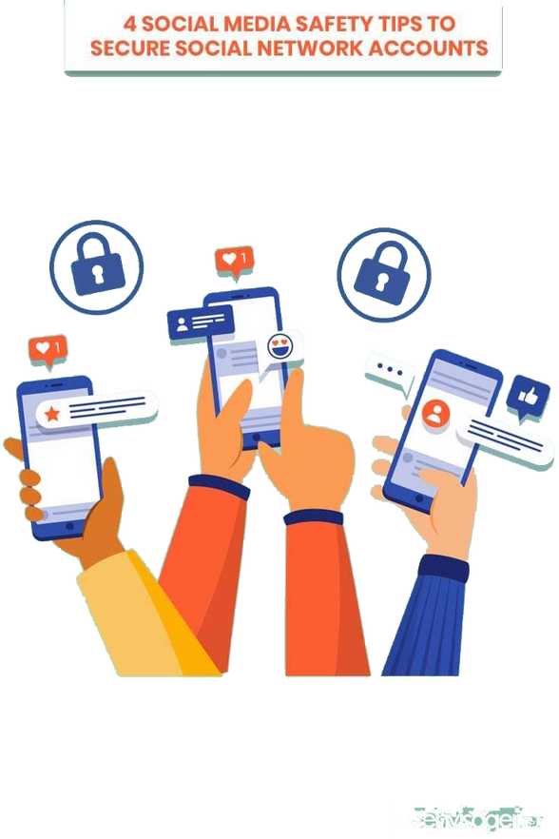
DIGITAL SAFETY TIPS
SOCIAL MEDIA SAFETY
Be cautious about what you share on social media. Don't post personal information like your address or phone number. Be mindful of what you share and who you share it with.
10

Slide 11
DIGITAL SAFETY TIPS
Email Safety
1. Never click links or download attachments from unexpected sources
2. Verify sender addresses carefully, especially for important requests
3. Use multi-factor authentication whenever possible
4. Keep email filters and security software updated
Authentication & Passwords
1. Use unique, strong passwords for each account
2. Enable two-factor authentication on all important accounts
antivirus software
3. Never enter credentials unless you're certain of the site's legitimacy
4. Use a password manager to generate and store complex passwords
11

Slide 12
DIGITAL SAFETY TIPS
General Security Habits
1. Maintain regular software updates
2. Back up important data regularly
3. Use security features like spam filters and antivirus software
4. Trust your instincts - if something seems suspicious, it probably is
12

Slide 13

DIGITAL SAFETY TIPS
PRIVACY SETTINGS
Check your privacy settings on social media and other online accounts. Make sure you're only sharing information with people you trust.
13

Slide 14
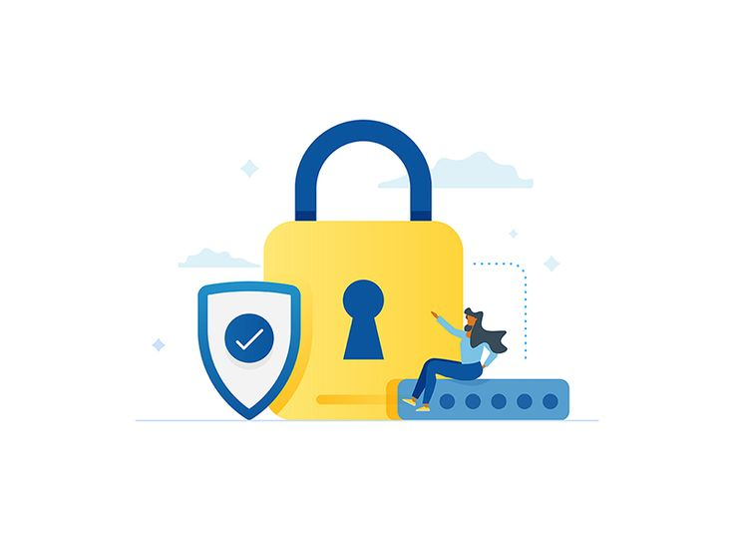
DIGITAL SAFETY TIPS
SUSPECTING PHISHING ?
1. Don't Panic or Rush
Take time to verify requests through alternate channels
Remember that legitimate organizations won't pressure you for immediate action
2. Report the Incident
Forward suspicious emails to your IT security team
Report phishing attempts to relevant authorities
Document the incident for future reference
3. If You've Been Compromised
Change passwords immediately
Contact your bank or credit card company if financial information was exposed
Monitor accounts for suspicious activity
Consider credit monitoring services
14

Slide 15
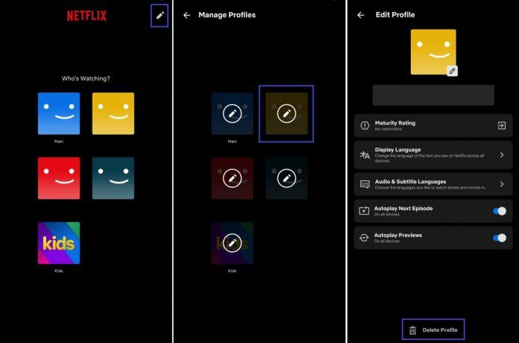
DIGITAL SAFETY TIPS
REAL-WORLD EXAMPLE
Netflix Account Verification
Phishing Email:
"Dear Netflix User, We've detected unusual activity on your account. Click here to verify your payment
information within 24 hours to prevent account suspension."
Red Flags :
Generic greeting
Urgent timeline
Request for payment information
Link to unofficial domain
15

Slide 16



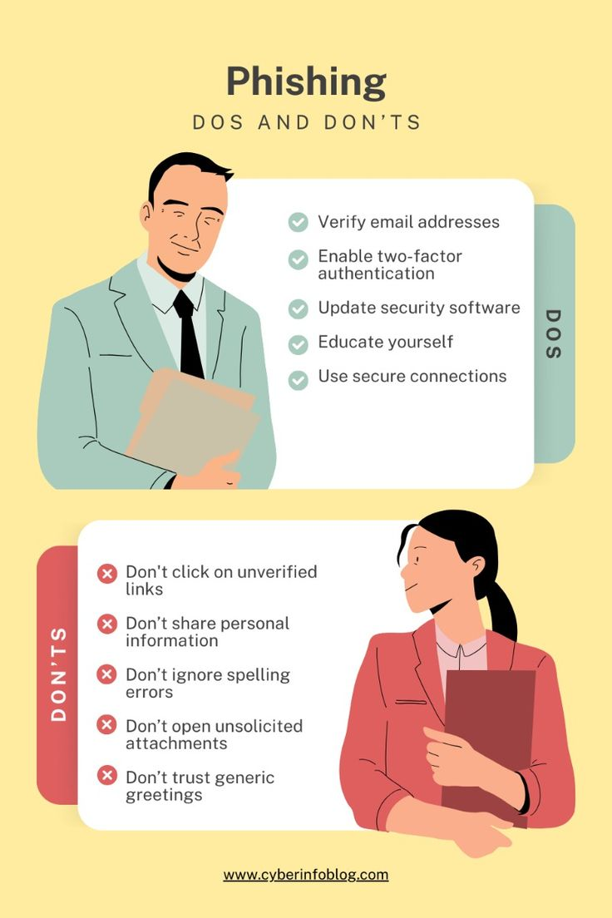

CONCLUSION
Phishing attacks continue to evolve, but staying informed and vigilant is your best defense. Remember :
Take time to verify suspicious requests
Trust your instincts
Keep security measures updated
Report suspicious activity
Stay informed about new phishing tactics
16

Slide 17



THANK YOU FOR LISTENING!
Don’t hesitate to ask any questions.
Remember : When in doubt, verify through official channels and never rush into providing sensitive information or taking urgent action based on unexpected requests.

